Slide 1

Algorithm/ Flowchart
Design

Slide 2
Algorithm
•It is a step by step procedure in solving a problem
•A lists of sequence procedures in carrying out a particular task
•It does not follow any grammatical rules, it represents a high level of solution to a problem

Slide 3
Representation of an Algo
•Pseudocode –a straight English format.
•Flowcharting –the diagrammatic representation of a sequence of events, usually drawn with conventional symbols representing different types events and their interconnections

Slide 4
Using Flowchart Symbols and Pseudocode Statements
•Flowcharts(pictorial representations) and pseudocode(English-like representations)are used by programmers to plan the logical steps for solving a programming problem
•Some professional programmers prefer writing pseudocode to drawing flowcharts, because using pseudocode is more similar to writing final statements in programming language

Slide 5
TYPES OF FLOWCHARTS
1.) System Flowchart–present the total picture without worrying about taking care of every detail.
2.) Program Flowcharts–depicts a main segment of a complete computer program.

Slide 6
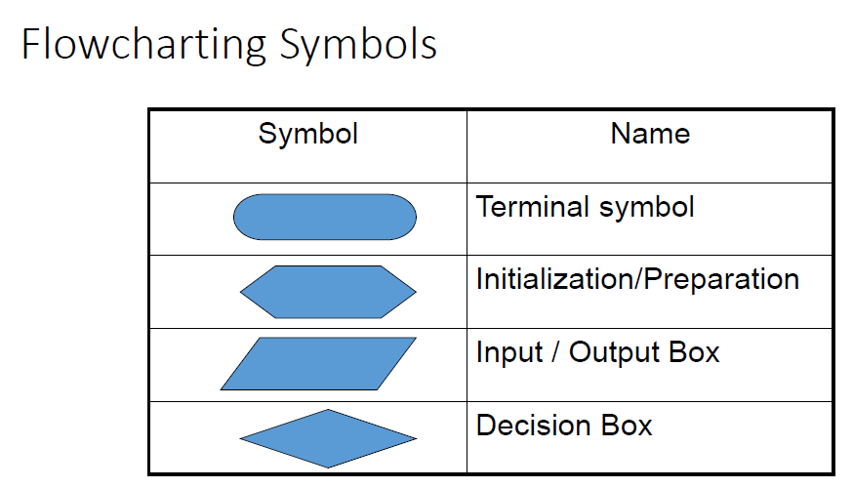

Slide 7
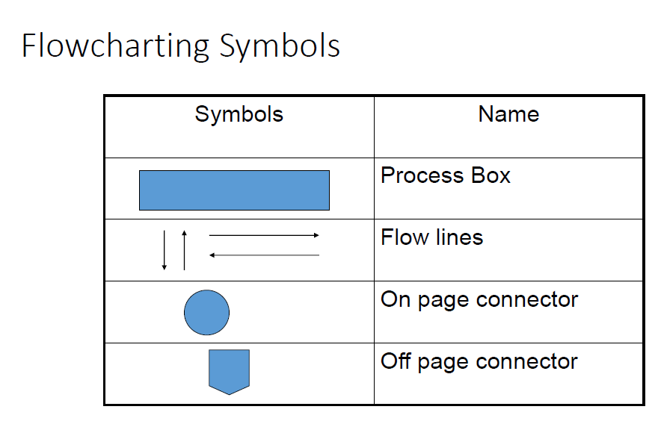

Slide 8
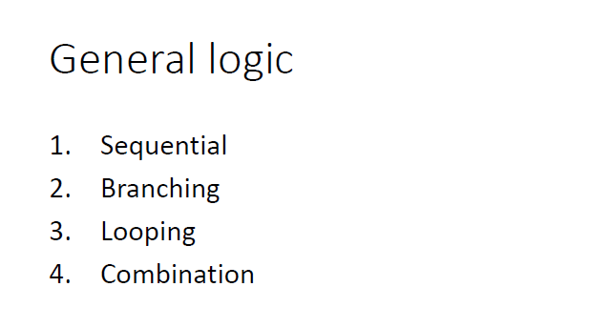

Slide 9
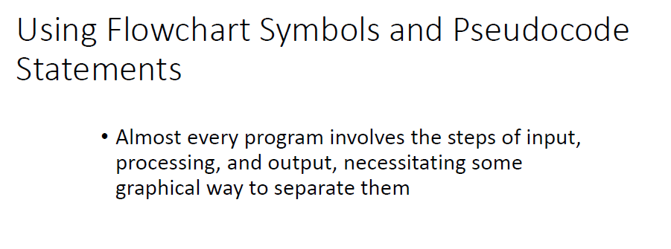

Slide 10
Program Elements & Structure

Slide 11
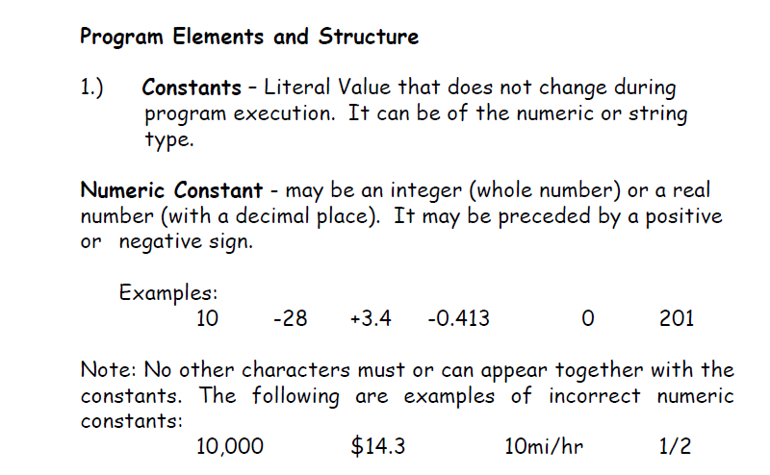

Slide 12
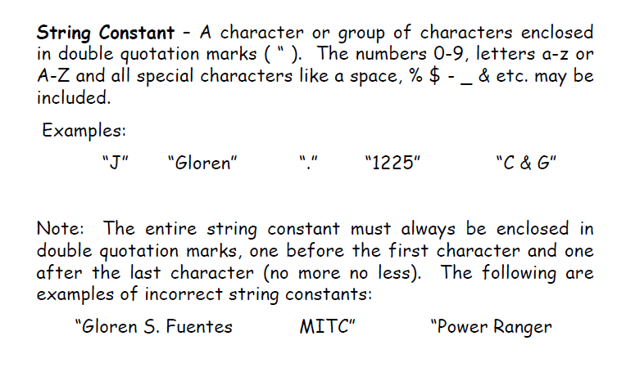

Slide 13
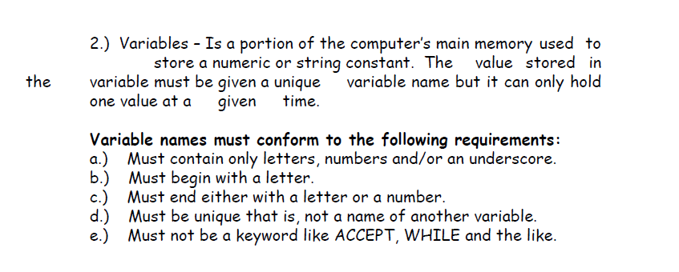

Slide 14
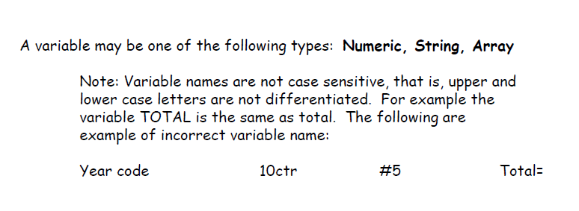

Slide 15
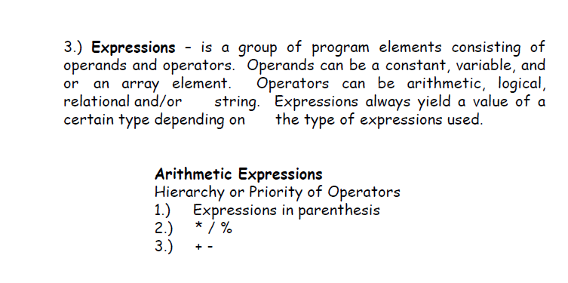

Slide 16
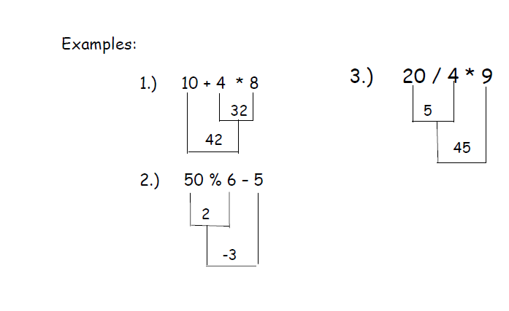

Slide 17
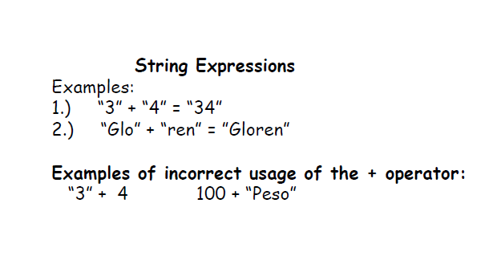

Slide 18
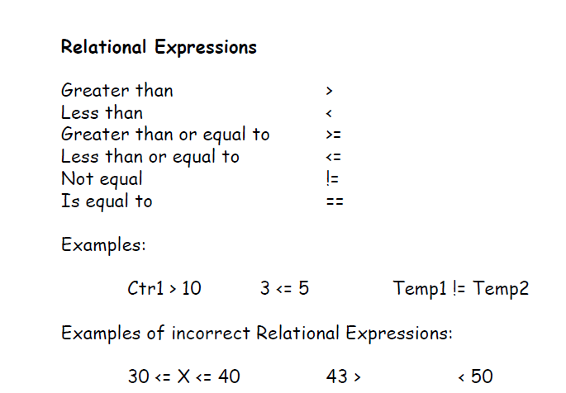

Slide 19
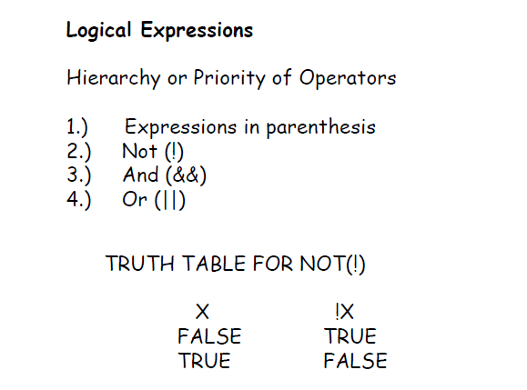

Slide 20
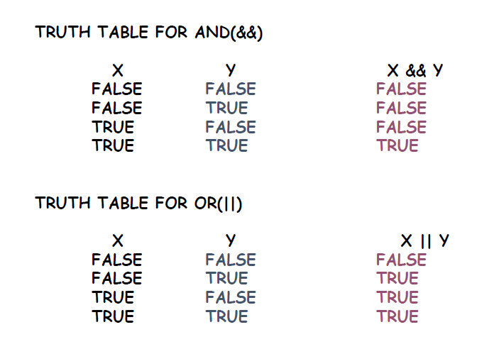

Slide 21
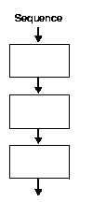
Sequential Program Structure

Slide 22
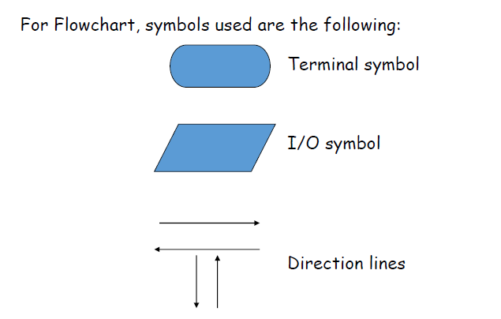

Slide 23
Pseudocode Syntax
Output:
Display “your string for prompt”
Display <var>
Display “your string”,<var>
Input:
Accept <var>
Accept <var1>,<var2>
Accept<var1>
Accept<var2>

Slide 24
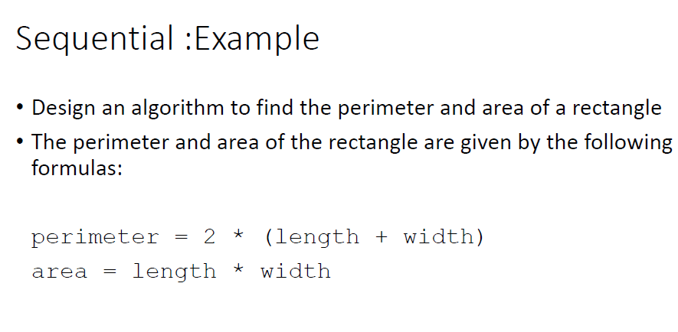

Slide 25
Sequential structure
Input a temperature in Celsius and output the corresponding temperature in Fahrenheit. The formula is a follows:
Fahrenheit = 9/5 (Celsius) + 32

Slide 26
Sequential structure
Pepperoni++ Pizza House charges 10% service charge and 5% sales tax on the gross bill of the customer. Create a flowchart and a pseudocode that would input the gross bill of the customer and the amount given by the customer to the waiter. It must output the customer’s total bill and change (if there’s any).

Slide 27
Sequential structure
Ten young men agreed to purchase a gift worth Php 10,000.00 for their idol: LA Lopez. In addition, they agreed to continue with their plan even if at least one of them drop out. Create a flowchart a pseudocode that would input the number of men who dropped out (assume 0 to 9 only) and output how much more will each have to contribute toward the purchase of the gift.

Slide 28
Sequential structure
Create a flowchart and a pseudocode that would input an integer number and then output its one’s digit or the right most digit.

Slide 29
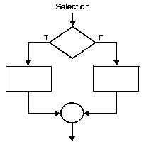
Selection/Conditional Program Structure

Slide 30
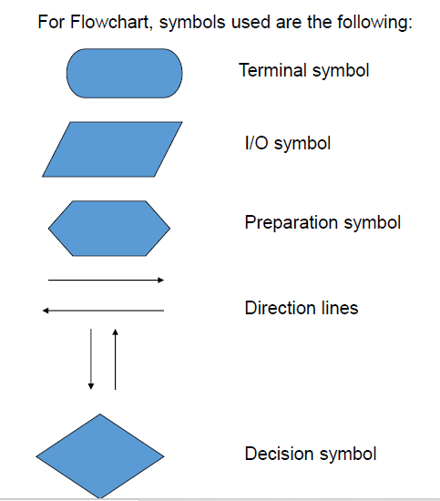

Slide 31
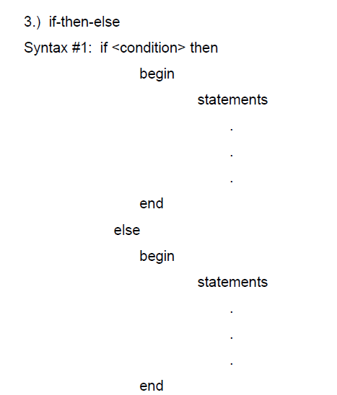
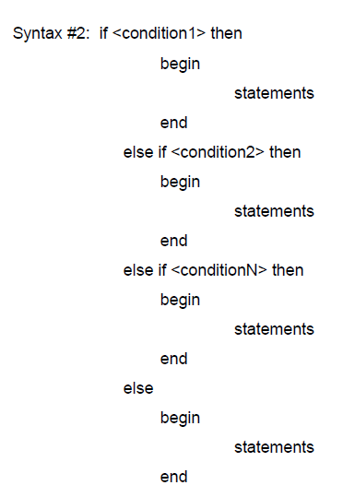

Slide 32
Selection/Conditional Structure
Create a flowchart and a pseudocode that would input an integer number and then indicate whether the number is an even or an odd number.

Slide 33
Selection/Conditional Structure
Juan dela Cruz Restaurant is offering a 20% discount to all customers whose last name is also dela Cruz. Input the last name of the customer and the total amount due to the customer and then output the amount to be paid.

Slide 34
Selection/Conditional Structure
Workers at Kookaburra Factory have a regular working hours of 40 hours per week and are paid Php 50.00 per hour. However, if the workers rendered more than 40 hours per week, the excess hours are paid 75% more. Create a flowchart and a pseudocode that would input the number of hours rendered by a worker in one week and output his net salary.

Slide 35
Selection/Conditional Structure
The fine for an over-speeding violation depends on the speed of the erring driver, as follows:
60 to 75 mph = Php 2000.00
76 mph and above = Php 4000.00
Create a flowchart and a pseudocode to input the car’s speed and then output the fine, if any.

Slide 36
Selection/Conditional Structure
Bongga Ka Day Inc. gives additional performance bonuses to its employees every year. The amount is dependent on the number of years of service of the employee as follows:
Years of Service Amount of Bonus
5 years and below 50% of monthly salary
6 years to 10 years 100% of monthly salary
11 years above Php 30,000.00 or twice the monthly salary, whichever is higher.

Slide 37
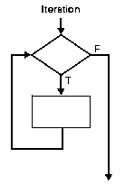
Iterative/Repetition Program Structure

Slide 39
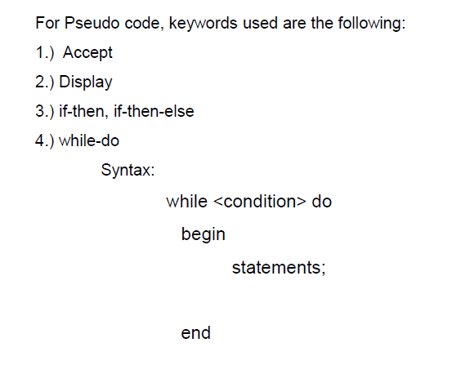

Slide 40
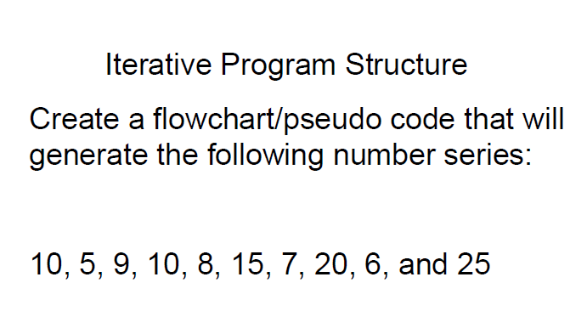

Slide 41
Iterative Program Structure
Create a flowchart/pseudo code that will generate the following number series:
1, 2, 4, 7, 11, 16, 22, 29, 37, and 46

Slide 42
Iterative Program Structure
Create a flowchart/pseudo code that will input five numbers and output how many of the numbers entered are odd or even.

Slide 43
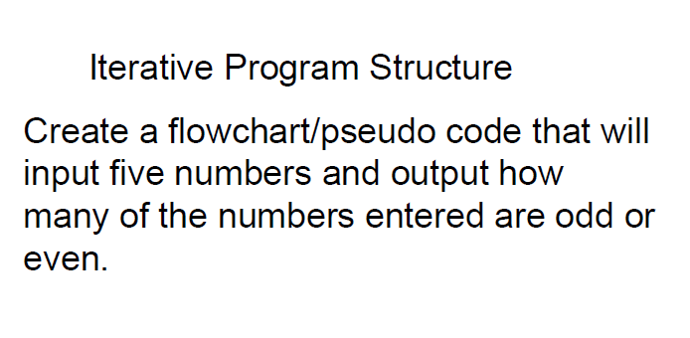

Slide 44


